Slide 1

Datawarehouse Comparisons: SQL vs. Snowflake
Rehan Khan

Slide 2



Agenda
Introduction
Problem
Goal
Process
Conclusion

Slide 3




Introduction
For this project, we wanted to understand some of the key differences between using Microsoft SQL Server and Snowflake as a data warehouse solution. We took a sample dataset and used it to run several tests to conclude which warehouse was a better fit from an enterprise perspective.

Slide 4

Problem
What is the most efficient way to store our enterprise data in a safe and reliable manner.

Slide 5
Goal
To get an overall understanding of the most efficient databases, as well as understand the differences between columnar and row-level database formats. In this project, we will be comparing Snowflake to

Slide 6
Project timeline and steps
II. Data Wrangling
Cleaning, organizing and transforming raw data.
III. Exploratory Data Analysis
Step that identifies patterns in data and understanding outliers and features of dataset
IV. Data Pre-processing
Changing raw data into a clean, usable format to prepare for final step of creating the machine learning model
V. Modeling
Final step of the process where we apply different algorithms to processed data to see which model is most effective in predicting our target of a fraudulent transaction
I. Data Load
Load Adventure Works data to both systems

Slide 7
Data Wrangling
Column Name | Data Type | Content
SalesOrderID | integer | Unique ID for each individual order
OrderDate | date | Order Date
ProductID | integer | Unique ID for products sold
ProductName | string | Product name associated with ID
OrderQty | integer | Quantity of Units in order
UnitPrice | float | Price of item in USD
LineTotal | float | Total amount of order in USD

Slide 8
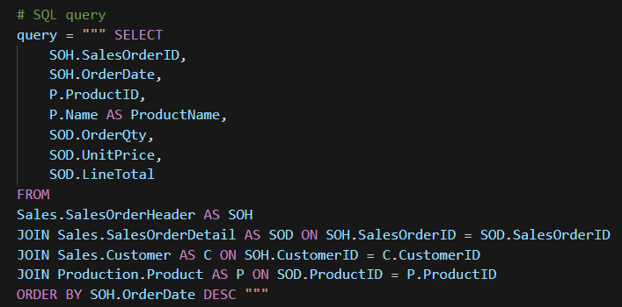
Data Wrangling
Snippet of query that was used to populate data for the exercise. This was fed into both SQL and Snowflake environments, respectively.

Slide 9
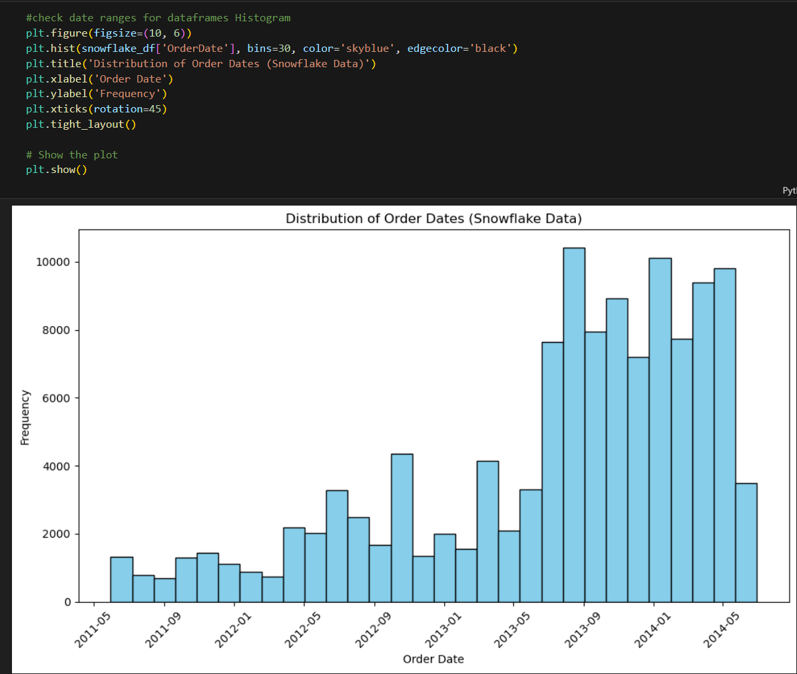
Exploratory Data Analysis
Figure on the right shows histogram of order dates taken from the Adventure Works query. We compared the same charts for both Snowflake and SQL. The chart on the right shows data from the Snowflake Dataframe.

Slide 10
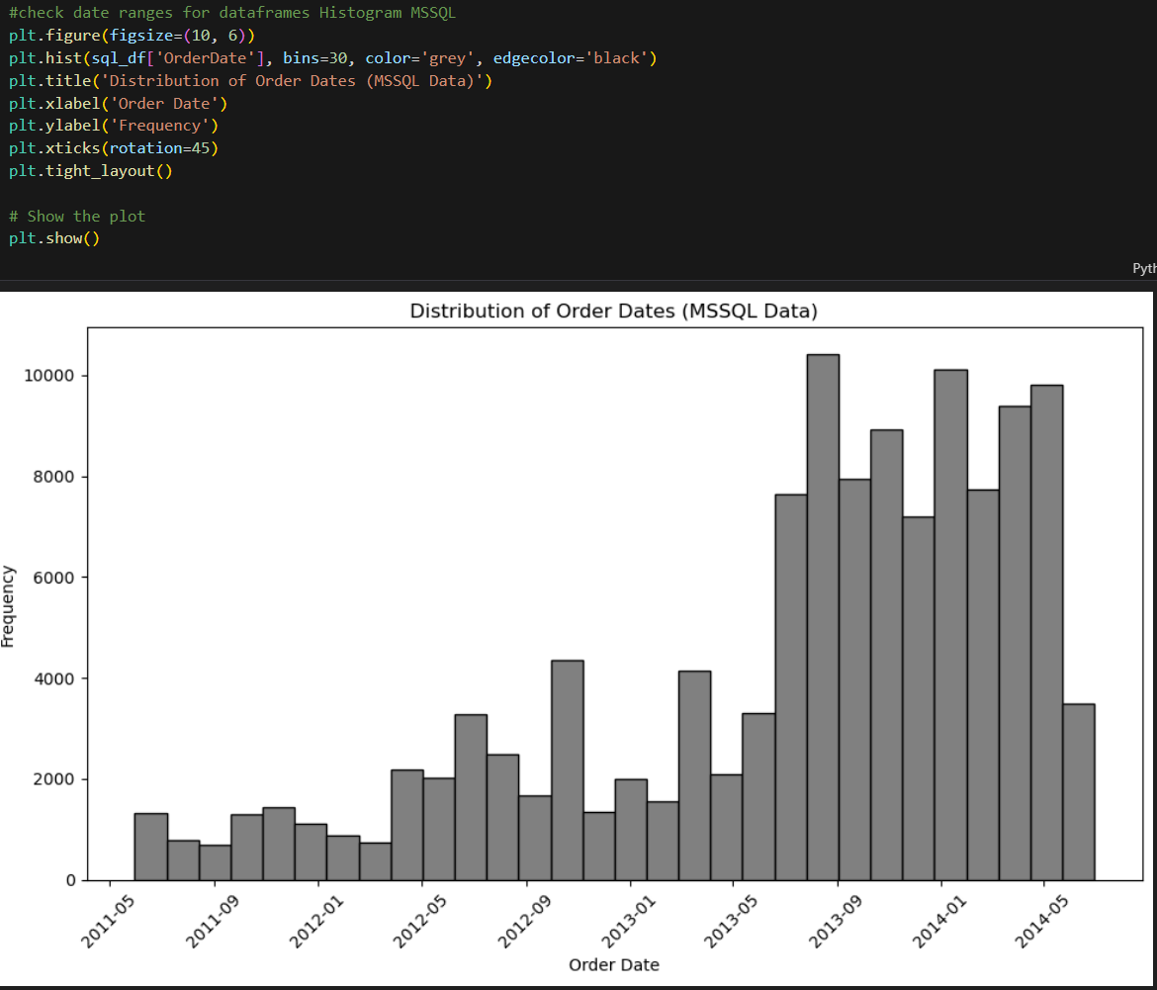
Exploratory Data Analysis
Figure on the right shows histogram of order dates taken from the Adventure Works query. We compared the same charts for both Snowflake and SQL. The chart on the right shows data from the SQL dataframe.

Slide 11
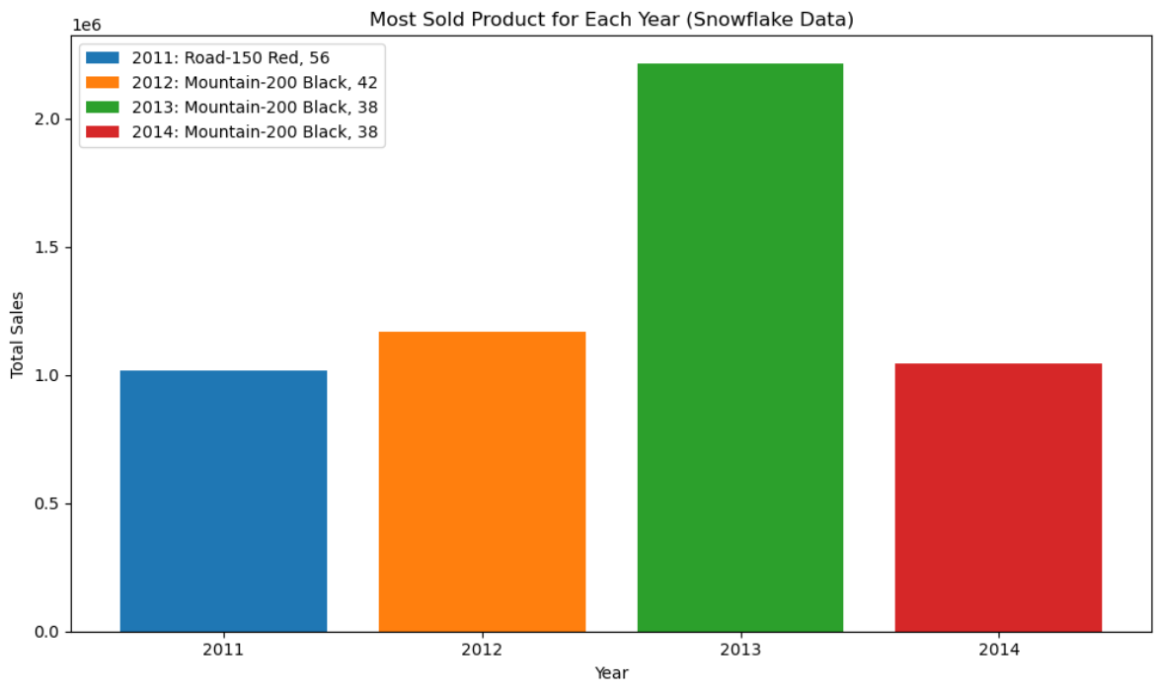
Exploratory Data Analysis
Figure to the right shows a bar chart with the most sold product in each respective year from 2011-2014. The data represented is from the Snowflake dataframe.

Slide 12
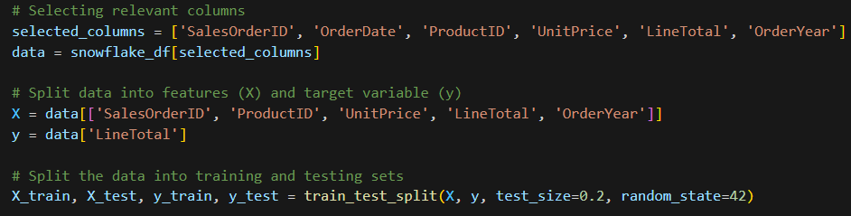
Data Preprocessing & Modeling
For this step, I wanted to create a simple model from our SQL and Snowflake data. We split out data into separate features with a target variable of “Line Total” to predict final prices. We use sci-kit learn to split our data.

Slide 13

Modeling
In this step, we established both a training and testing set, laying the groundwork for constructing our initial and fundamental model as a baseline. This baseline serves as a reference point, offering valuable insights into potential enhancements for our subsequent models. To establish this baseline, we initiated the process by standardizing the data, ensuring a uniform input regularization.

Slide 14
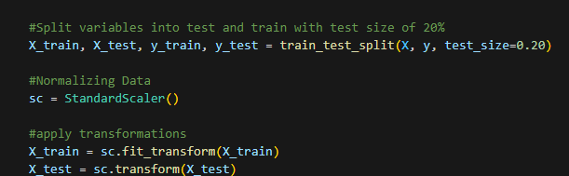
Modeling
Data was split with 20% going towards testing and 80% going towards training the model.

Slide 15
Models Used
Random Forest
Linear Regression

Slide 16
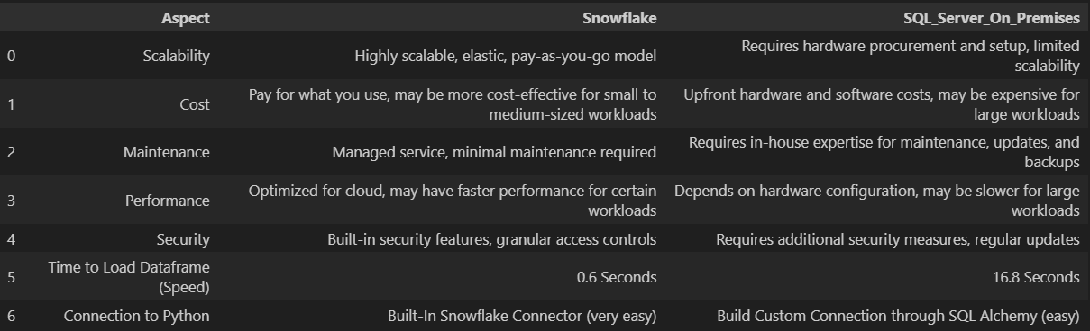
Conclusion
In summary, we crafted a comparison in the following categories:
Scalability
Cost
Maintenance
Performance
Security
Speed
Integrations

Slide 17
Conclusion
Based on these criterion we found Snowflake to be the better option.

Slide 18


Thank You

